Slide 1
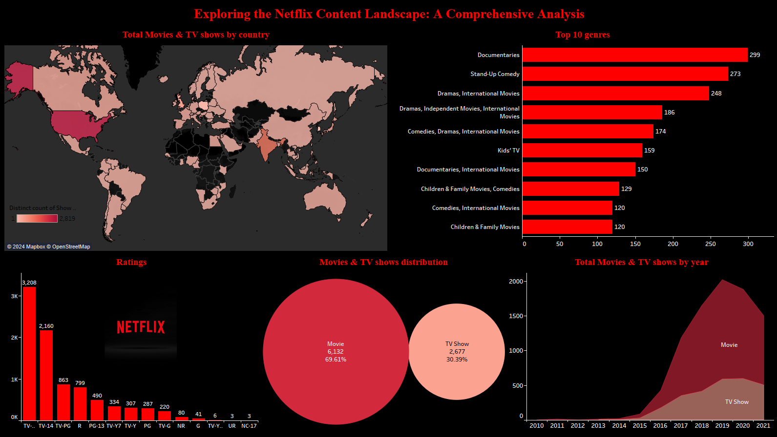
Insights
With a global perspective, highlights its international reach and cultural diversities
Top genres that captivates audiences providing a glimpse into viewer preferences.
Ratings play a crucial role, showcasing Netflix’s commitment to quality and potential for personalized recommendations.
Through final temporal dimension, it higlights Netflix’s adaptability to changing trends and audience preferences across different years.
Through this Comprehensive analysis, we gain valuable insights into Netflix’s global content landscape, it’s ability to cater to diverse audiences and the potential for content strategies that enhance the viewing experiences for viewers across the globe

